Slide 1

Market Recap and Outlook
2017
Presented by: Andy Murray, CFA
Portfolio Manager/Analyst
Becker capital Management

Slide 2
Becker Capital
Founded in Portland in 1976
      Offices in Portland & Seattle
Managing $3.8 Billion (as of 9/30/17) in multiple strategies for institutional and individual clients.
Experienced 11 member investment team averaging 29 years in the industry and 15 years at the firm.
Becker Capital Management

Slide 3

What’s Up and What’s Down in the Capital Markets?
Becker Capital Management

Slide 4
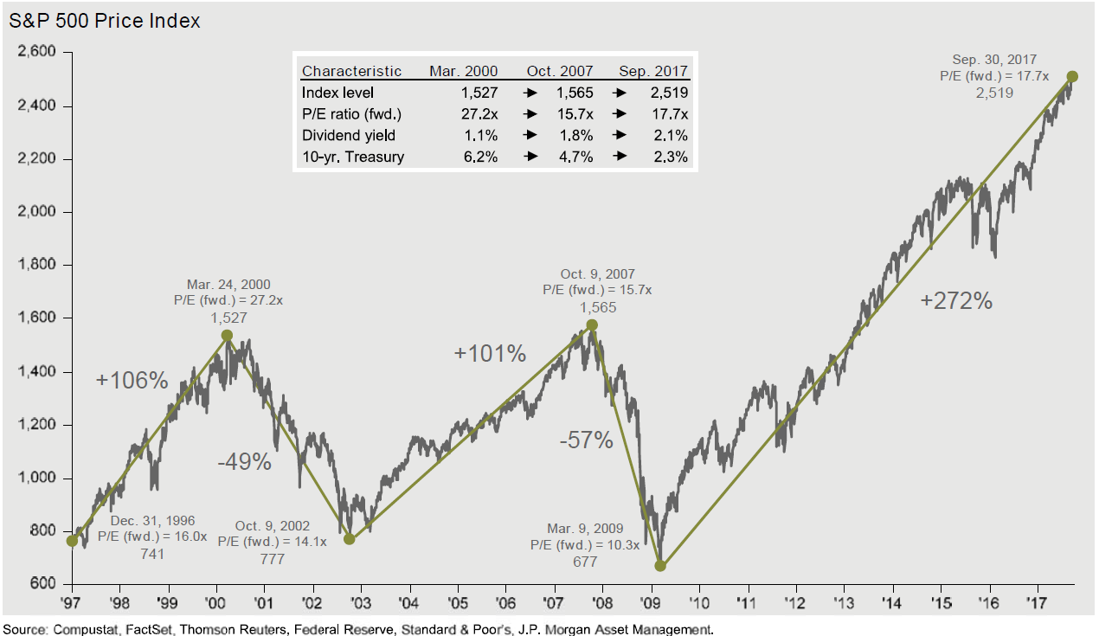
We are in an equity bull market
Becker Capital Management

Slide 5
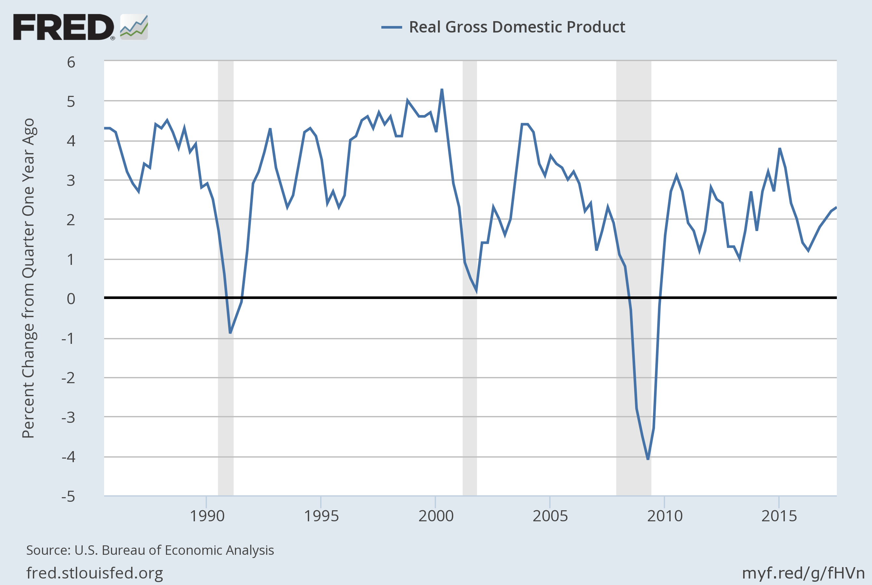
Driven by a recovery in economic growth
Data as of 10/27/17
Becker Capital Management

Slide 6
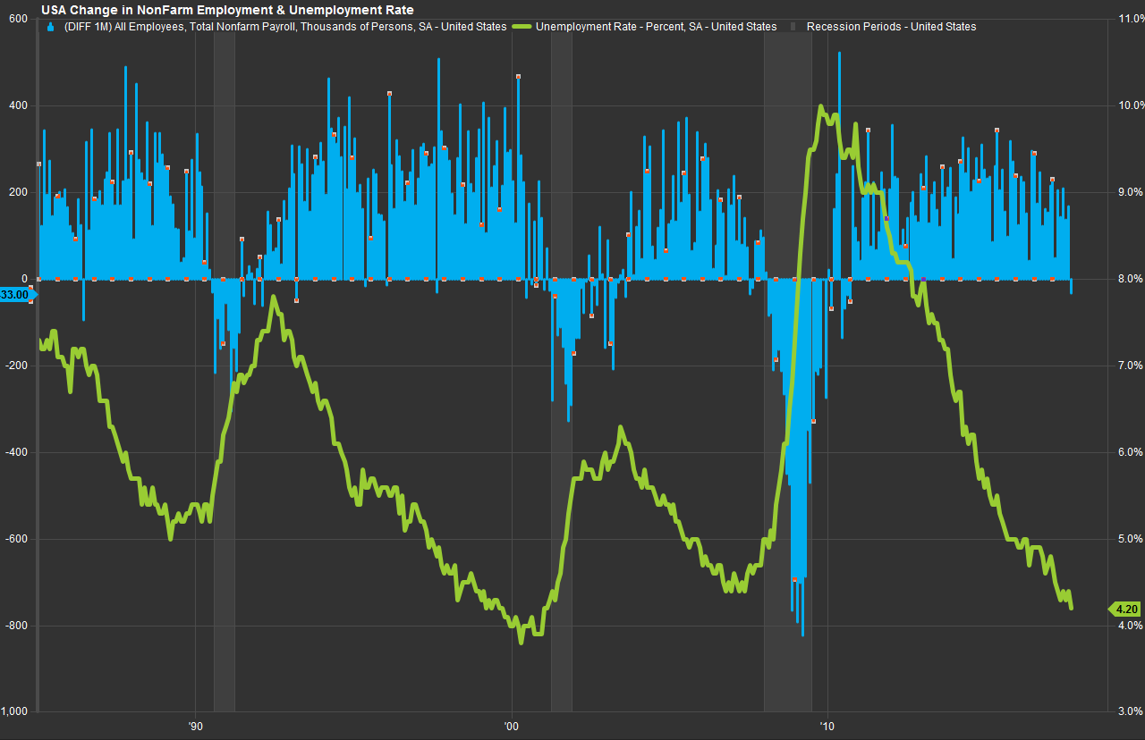
Employment (blue) is up and the unemployment rate (green) is near historic lows
Source: FactSet
Data as of November 3, 2017
Becker Capital Management

Slide 7
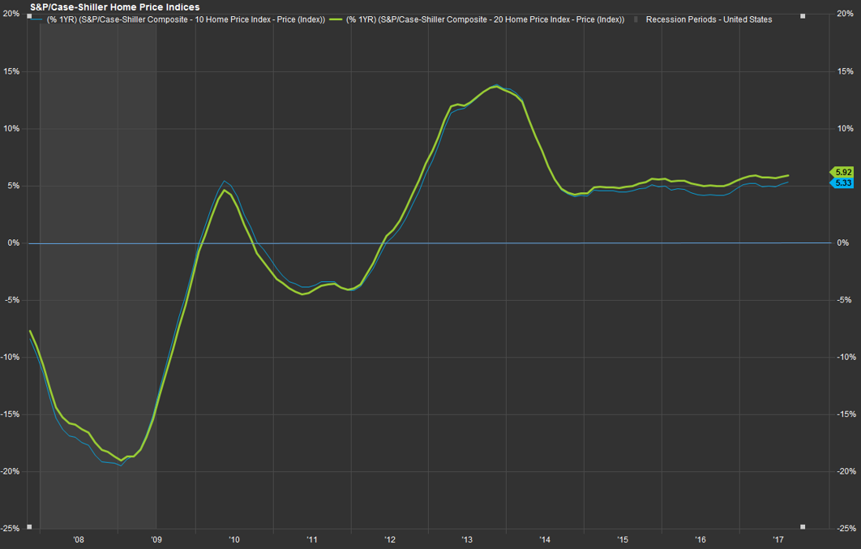
Home prices have been rising steadily for the last 5 years
Source: FactSet
Data as of November 3, 2017
Becker Capital Management

Slide 8
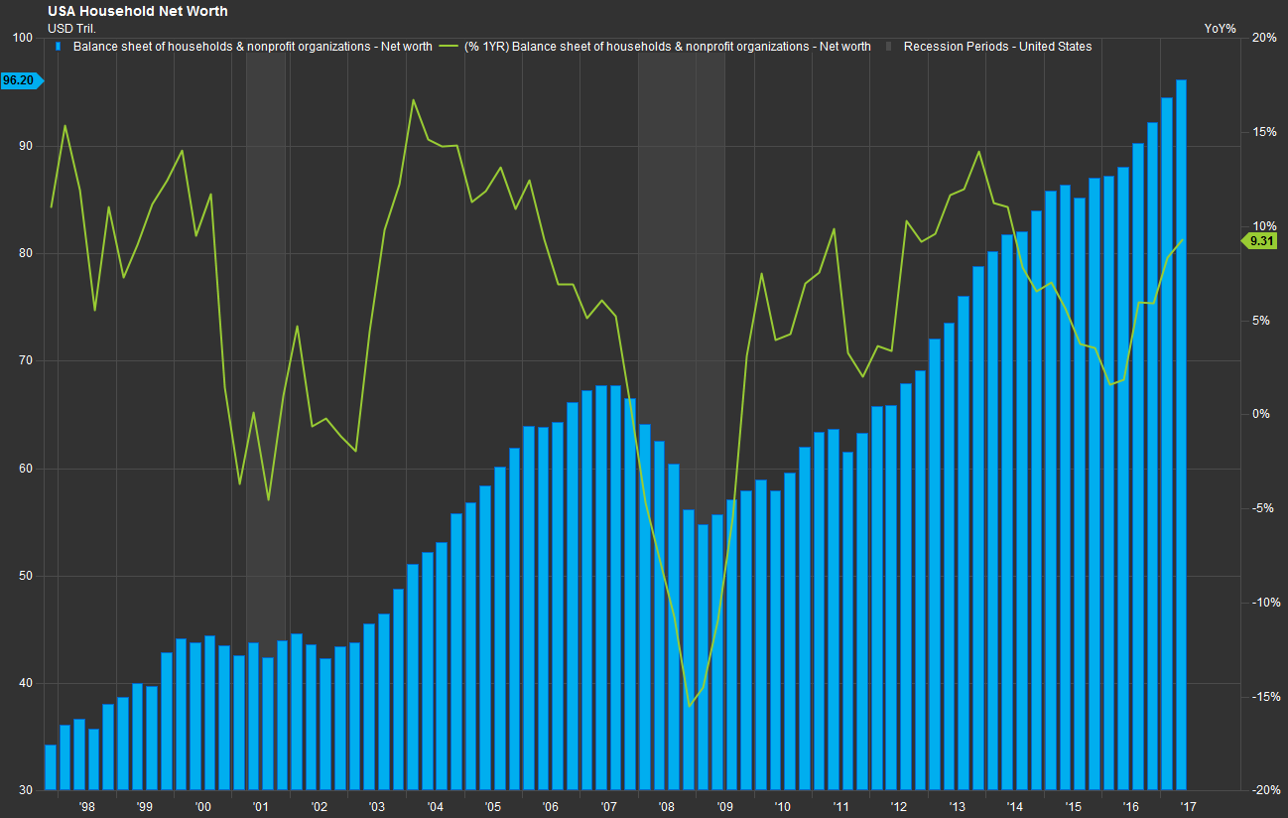
Household net worth is at all time highs
Source: FactSet
Data as of November 3, 2017
Becker Capital Management

Slide 9
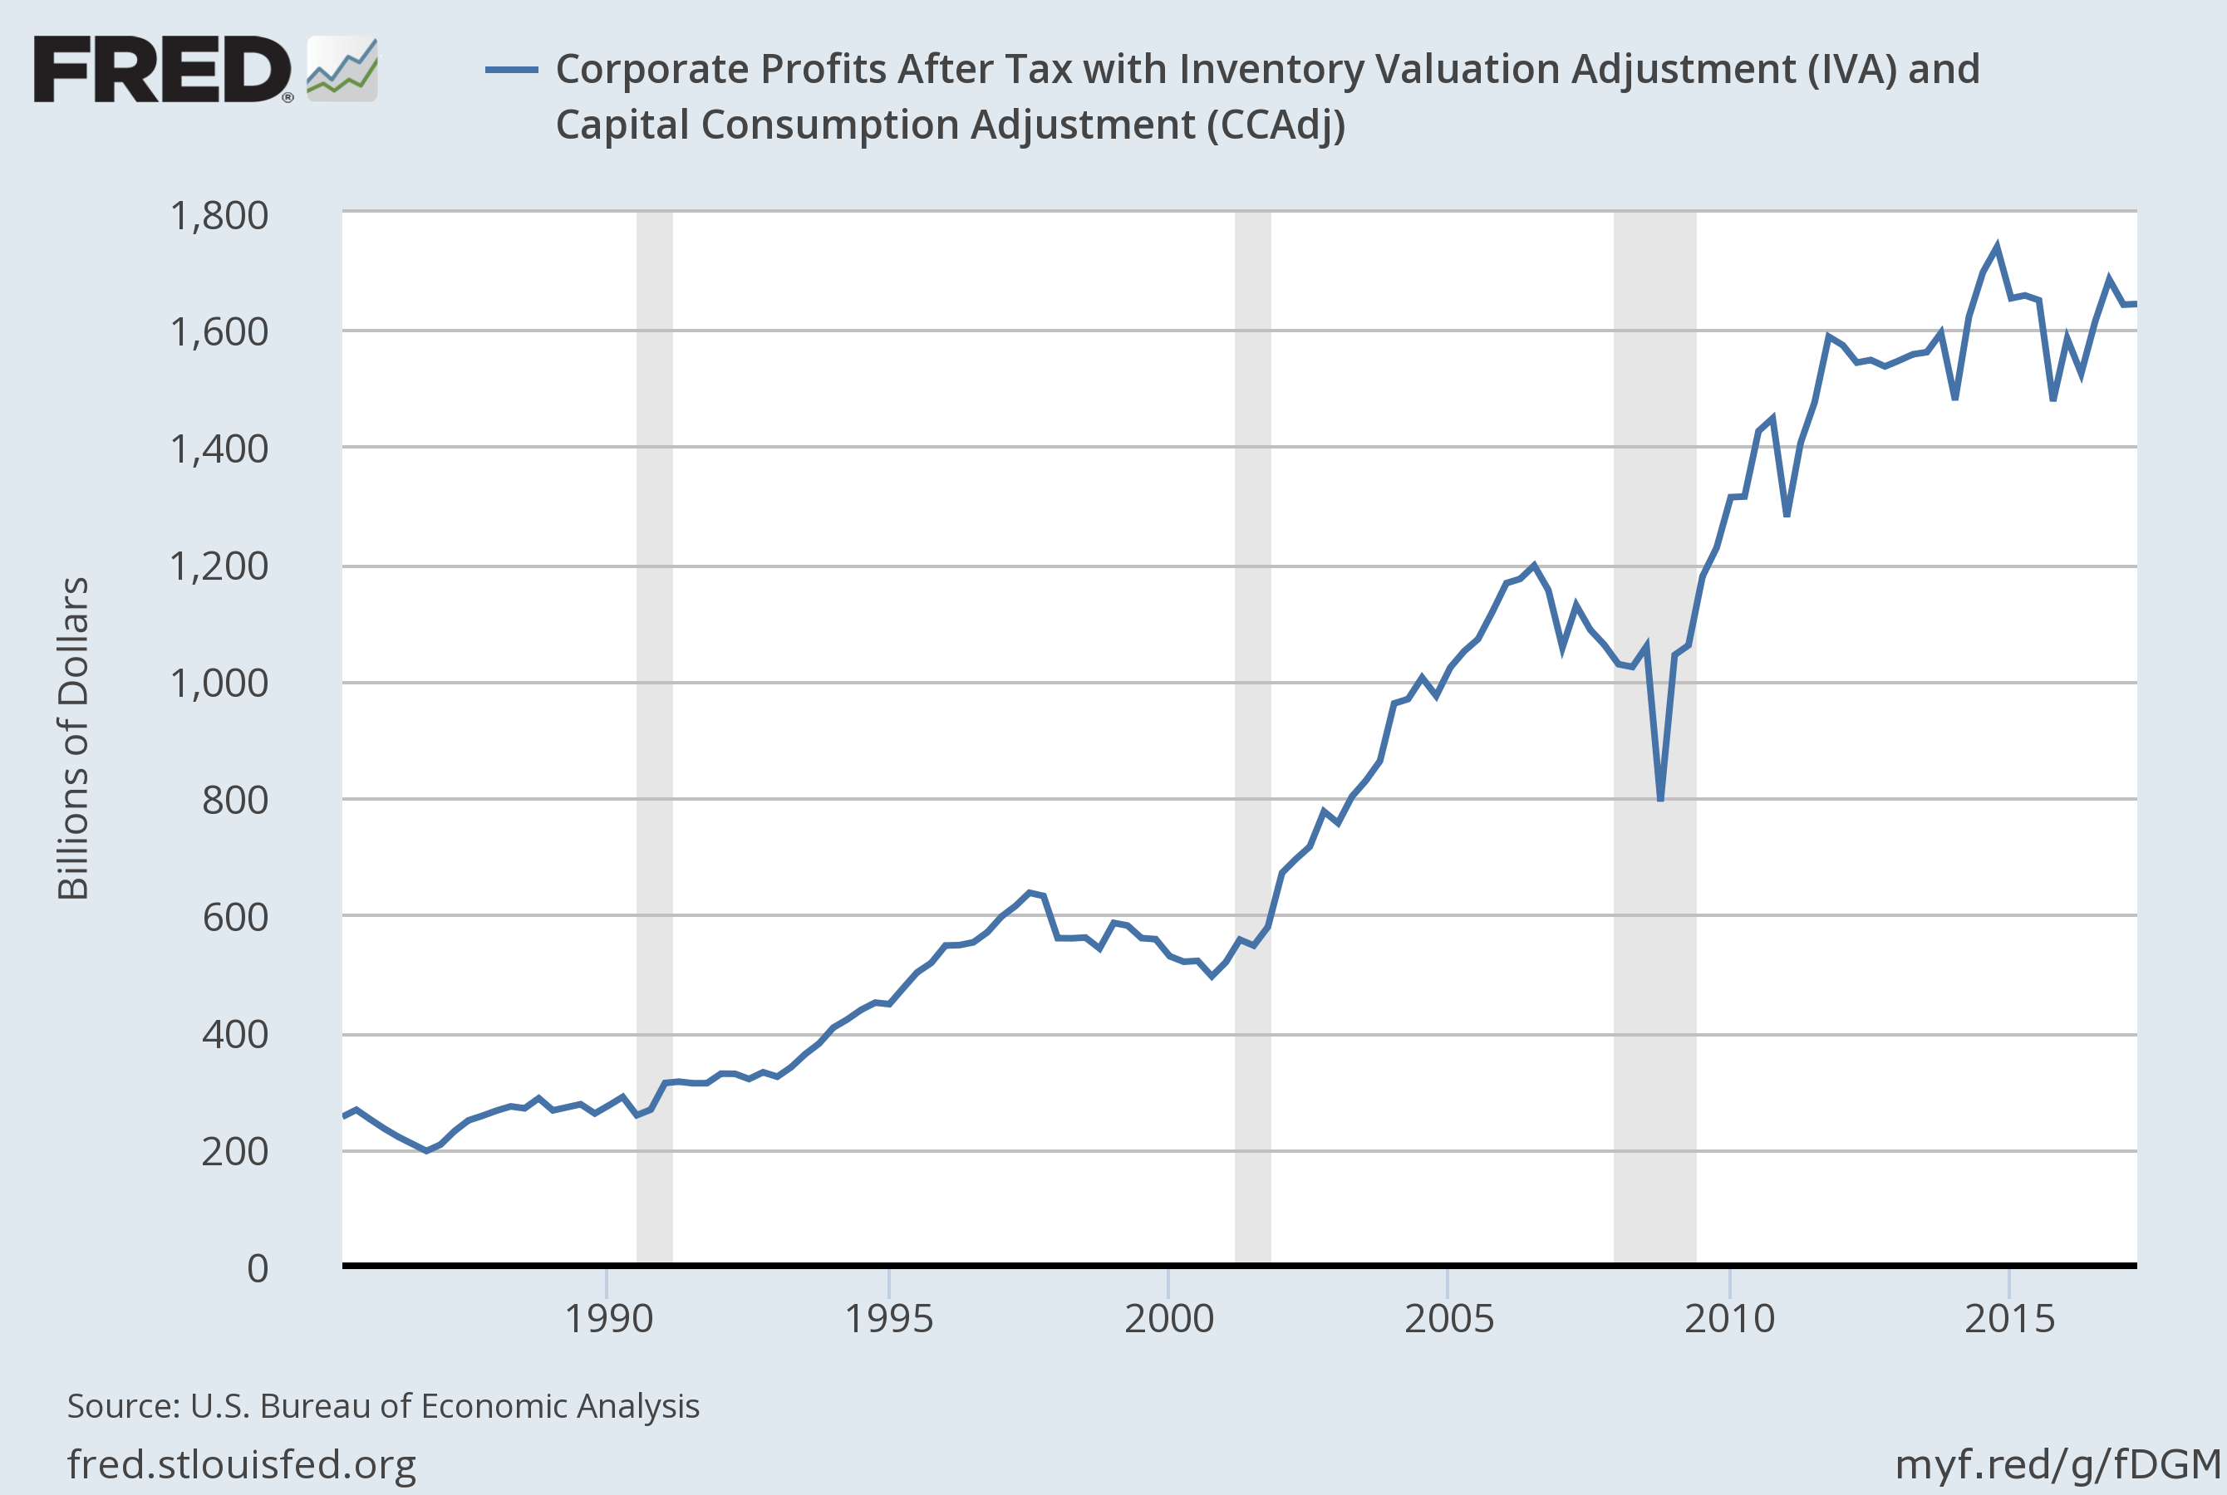
Corporate Profits have bounced back strongly from the great recession
Data as of 10/27/17
Becker Capital Management

Slide 10
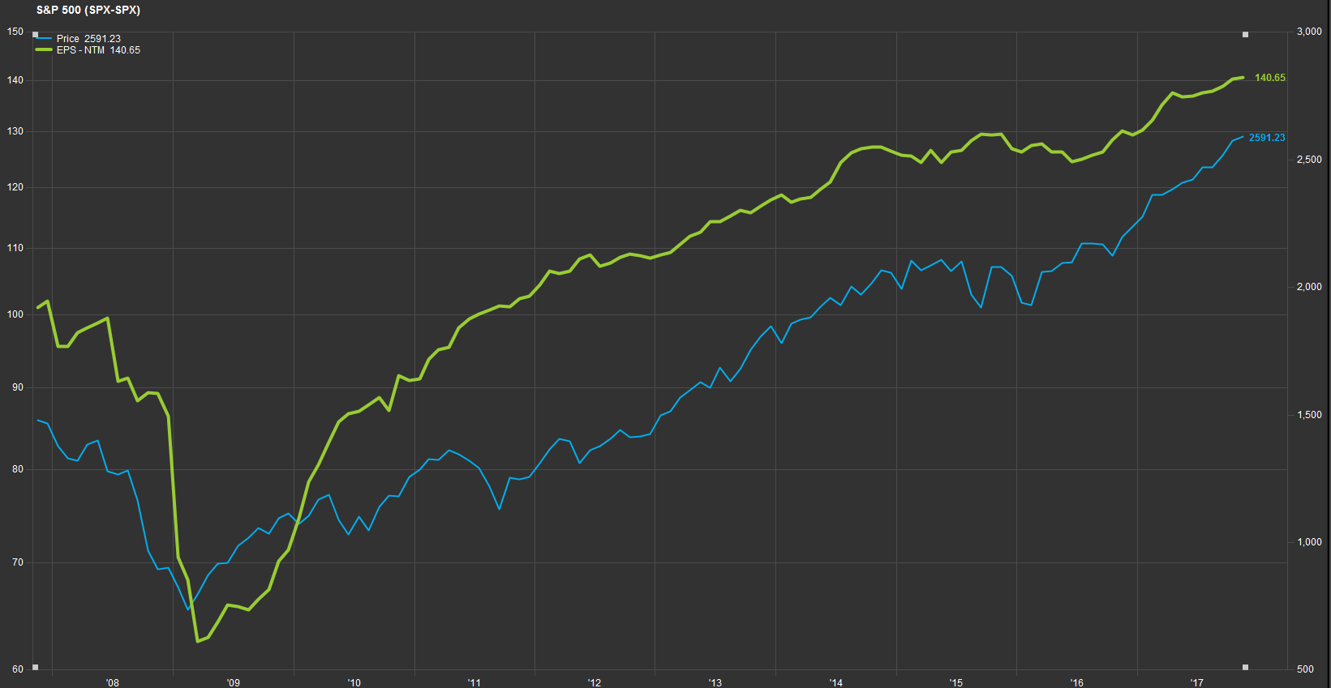
S&P500 earnings are at all time highs
Source: FactSet
Data as of November 3, 2017
Becker Capital Management

Slide 11
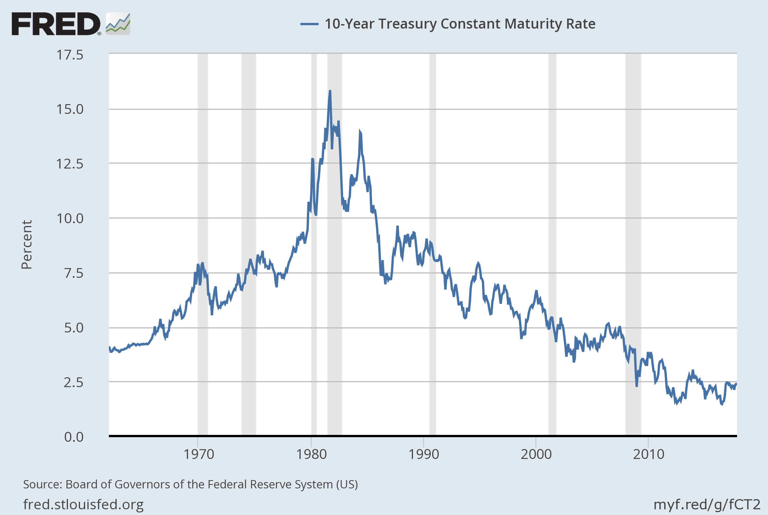
Interest rates remain at historically low levels
Data as of 10/31/17
Becker Capital Management

Slide 12
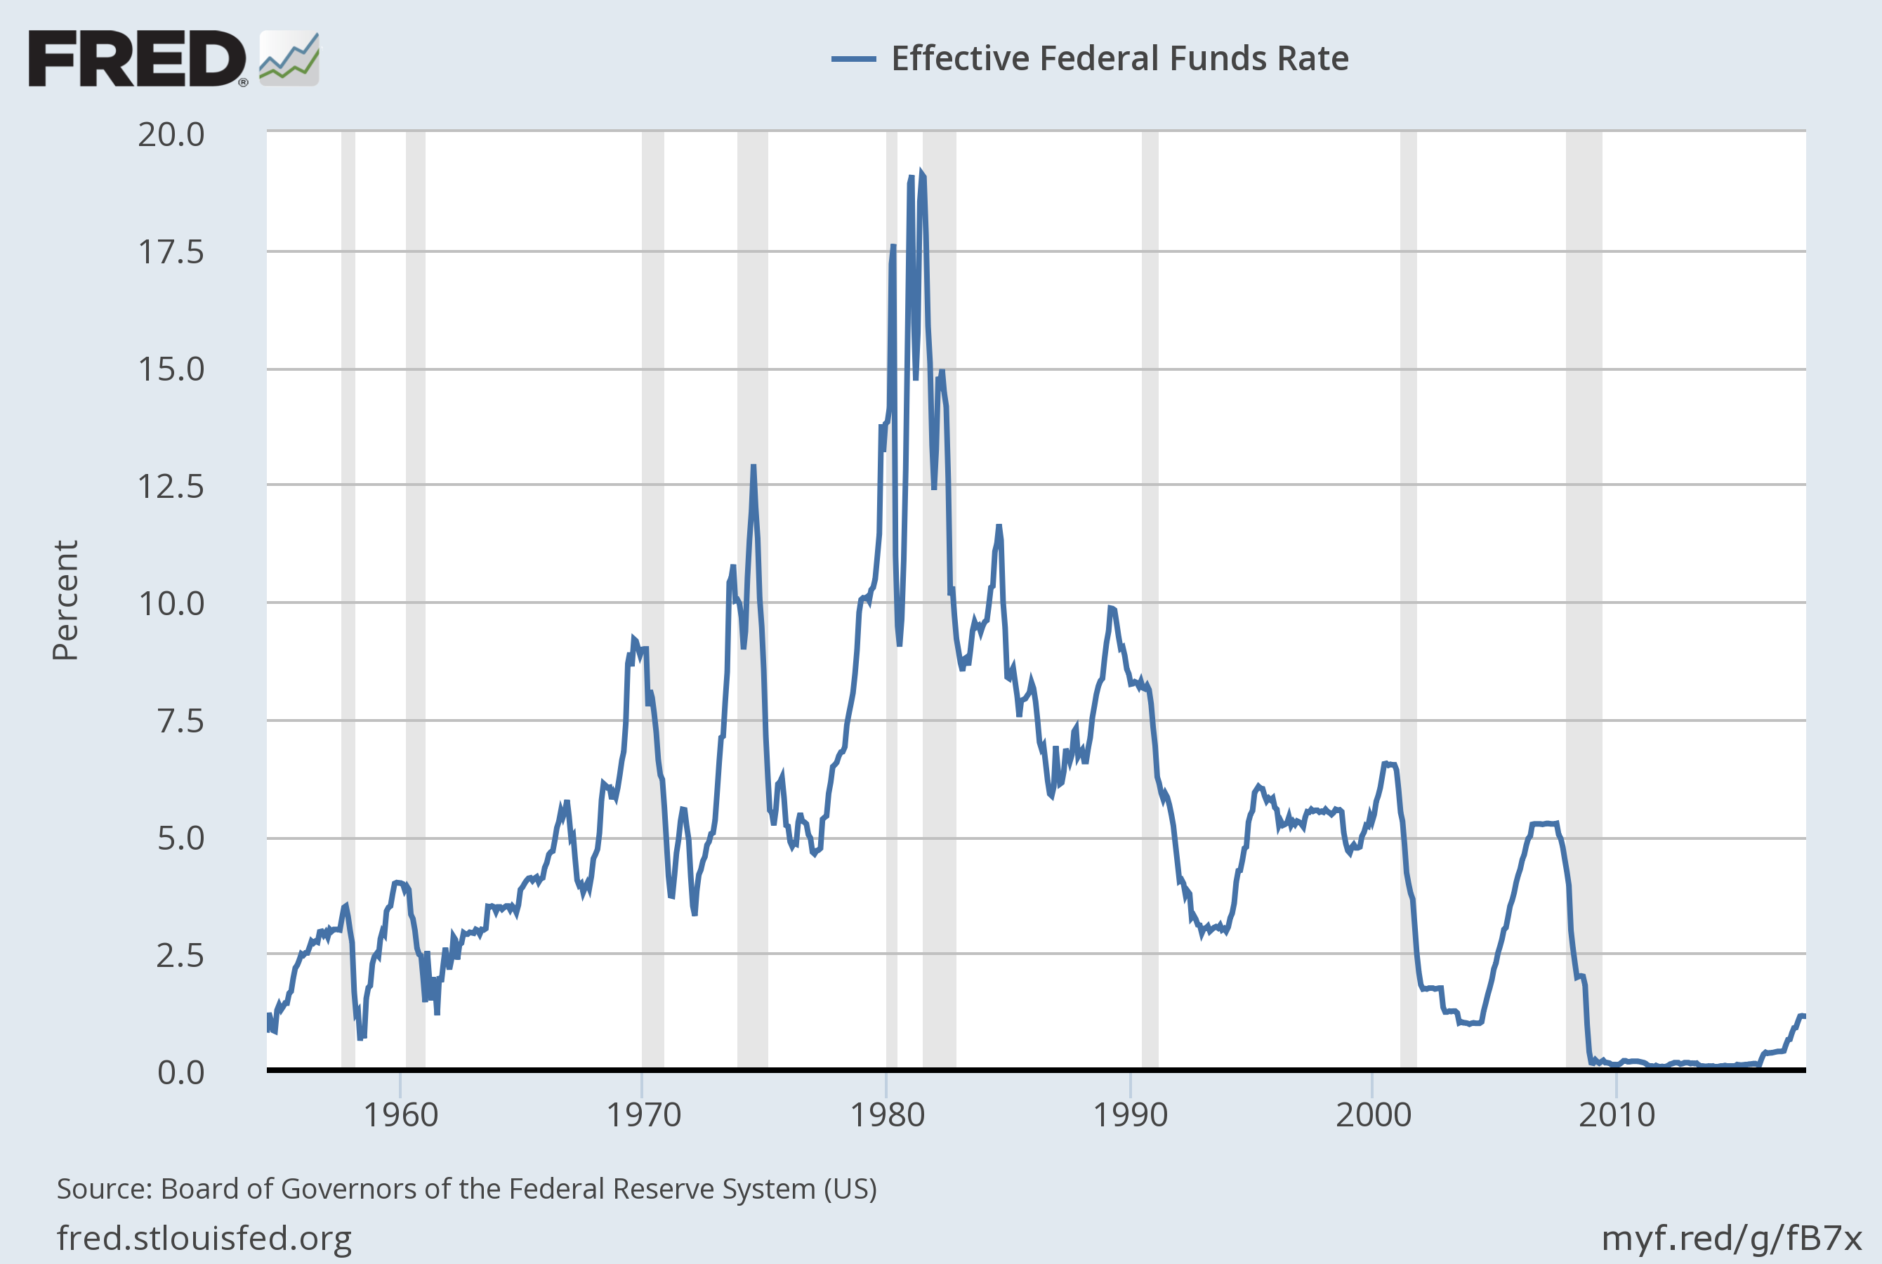
Despite recent moves to normalize monetary policy
Data as of 10/31/17
Becker Capital Management

Slide 13

So what are the clouds on the horizon?
Why is this the most hated bull market in history?
Becker Capital Management

Slide 14
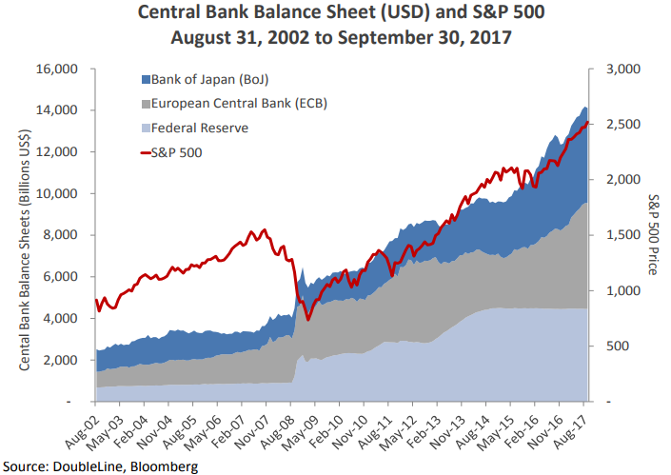
The impact of quantitative easing is hard to quantify but somewhat troubling
Becker Capital Management

Slide 15

Which is kinda scary
Becker Capital Management

Slide 16
If we look at ‘cyclically-adjusted’ earnings (which takes the 10-year average), the market looks a lot more expensive
Source: Robert Schiller
Data as of 11/01/17
Becker Capital Management

Slide 17

Very scary
Becker Capital Management

Slide 18
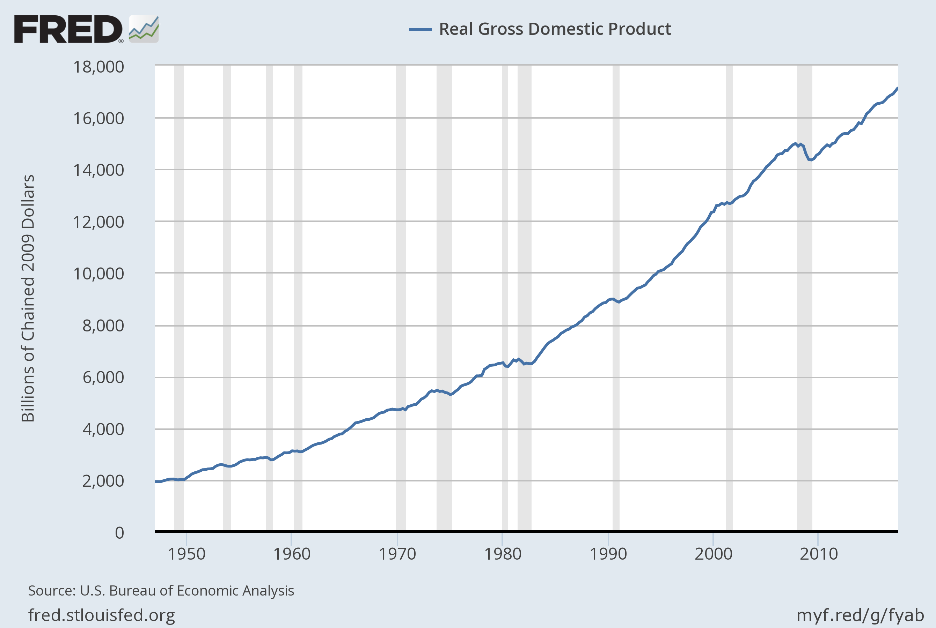
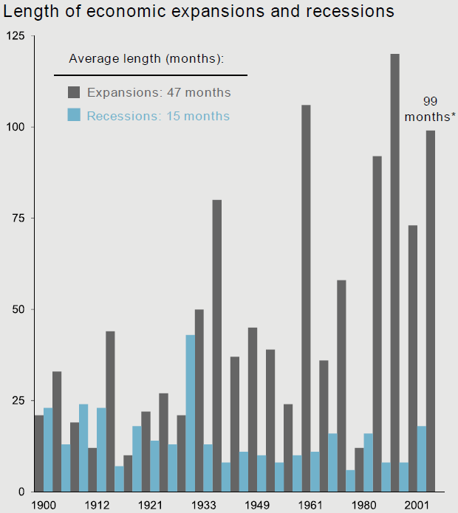
And the economic recovery has been going on a long time…..
Data as of 10/31/17
Data as of 09/30/17
Becker Capital Management

Slide 19

So why not run from this market?
Becker Capital Management

Slide 20
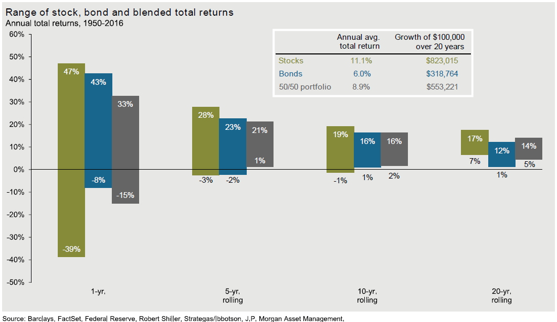
Over the long-term, equities are a great asset class despite potential short term volatility
Becker Capital Management

Slide 21
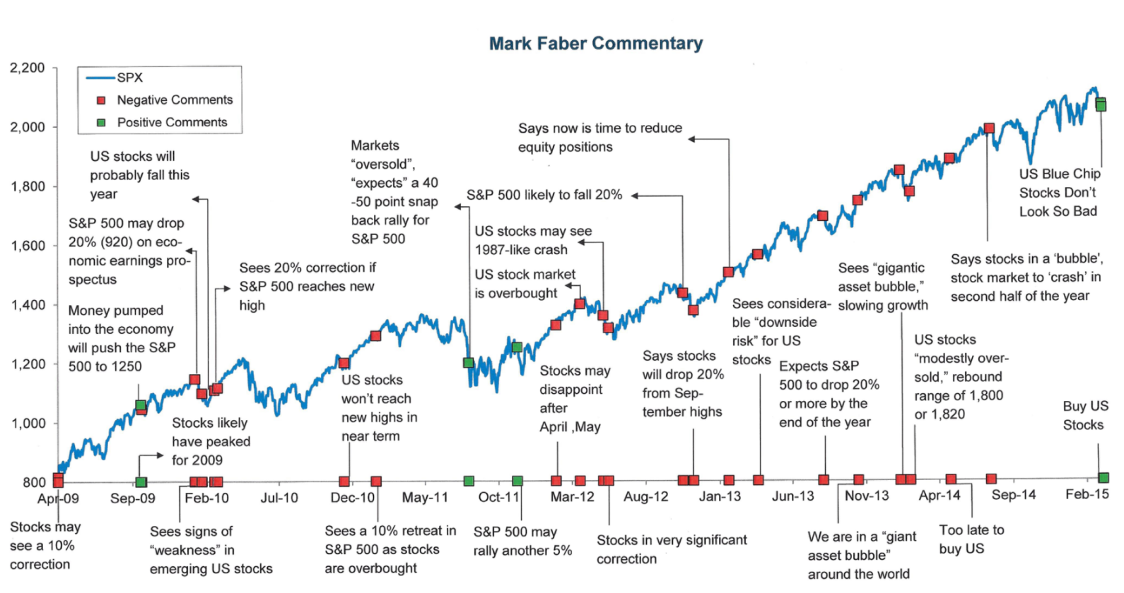
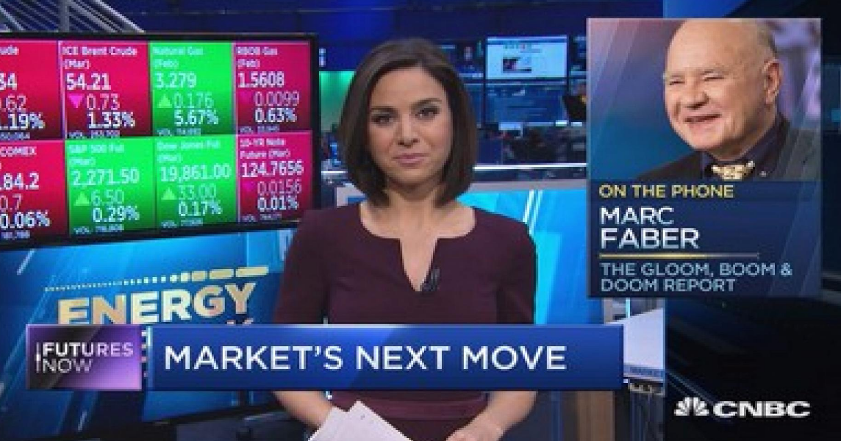
And it is easy to be scared
Source: The Big Picture, Barry Ritholtz, 2016
Becker Capital Management

Slide 22
“Far more money has been lost by investors preparing for corrections, or trying to anticipate corrections, than has been lost in corrections themselves.”
Peter Lynch
Becker Capital Management

Slide 23
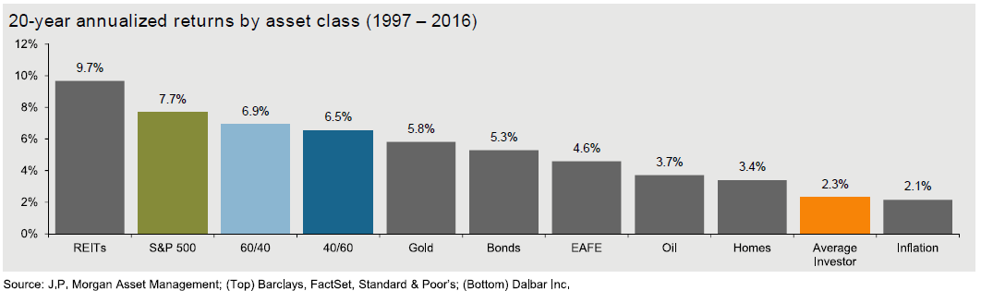
One must keep a long-term mindset to avoid buying high and selling low
Becker Capital Management

Slide 24
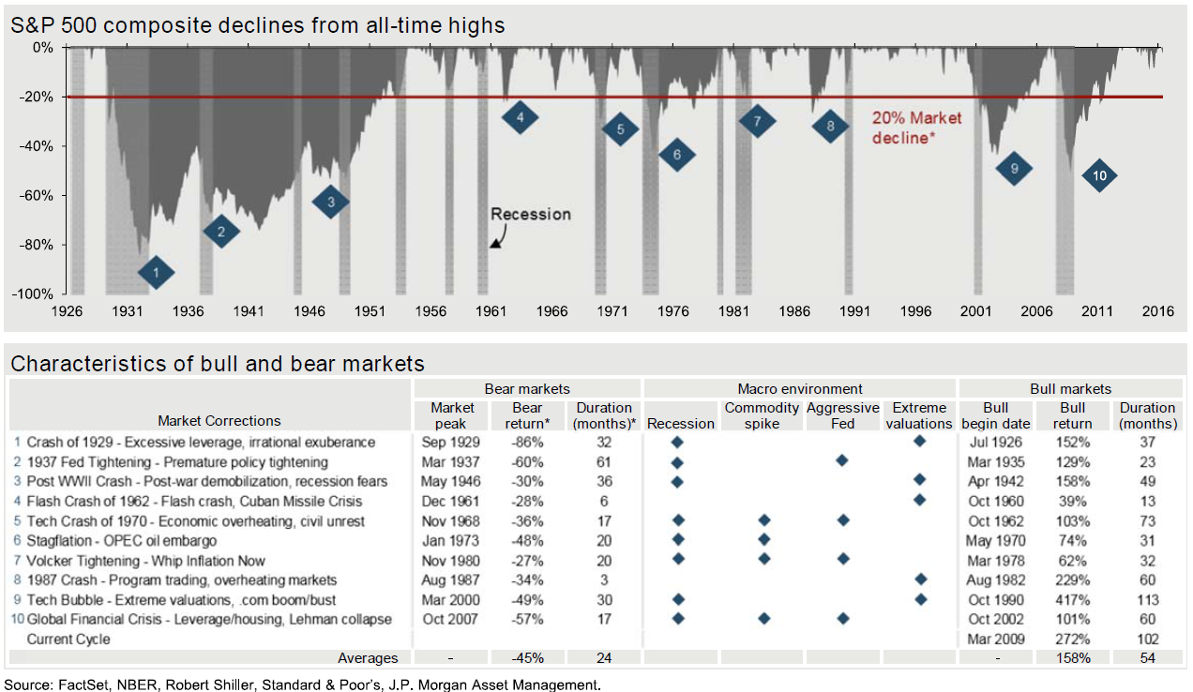
So what makes us scared? What do we watch for? What causes big stock market corrections?
Becker Capital Management

Slide 25
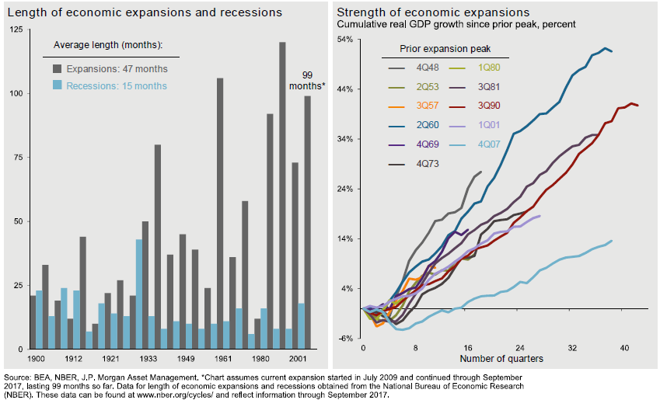
Recession watch
It is an unusual economic cycle
Becker Capital Management

Slide 26
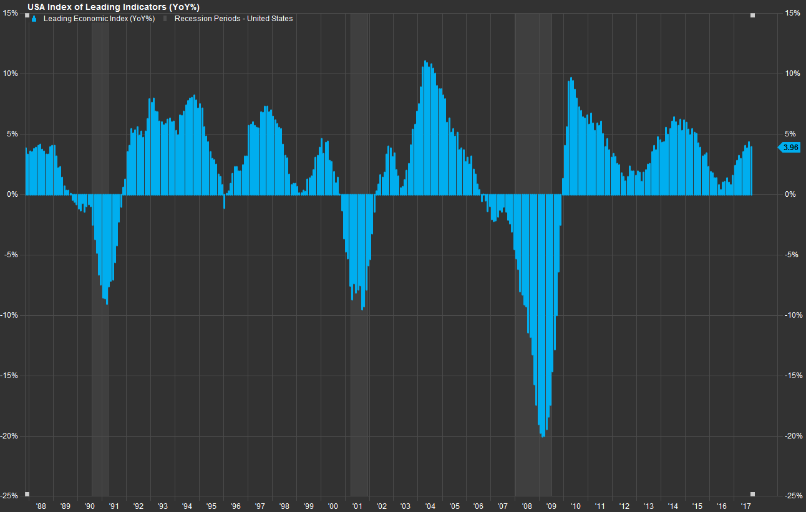
And some key warning signs are still OK: Leading economic indications are positive
Source: FactSet
Data as of November 3, 2017
Becker Capital Management

Slide 27
And unemployment trends have not deteriorated – another harbinger of recession
Source: FactSet
Data as of November 3, 2017
Becker Capital Management

Slide 28
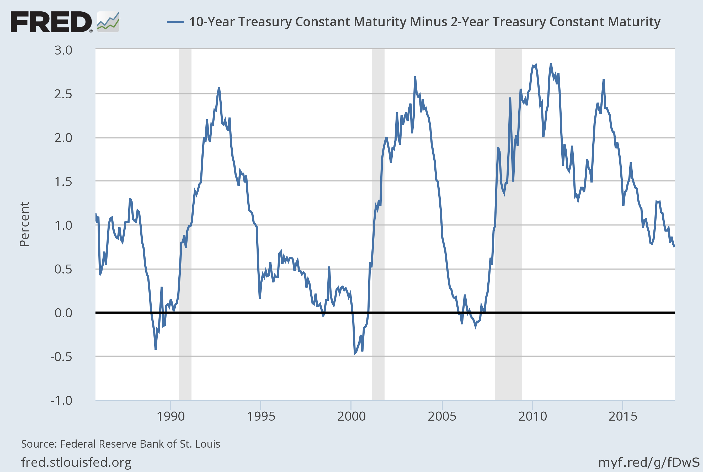
And the 10Yr-2Yr spread also suggests no recession is imminent
  Data as of 11/02/17
Becker Capital Management

Slide 29
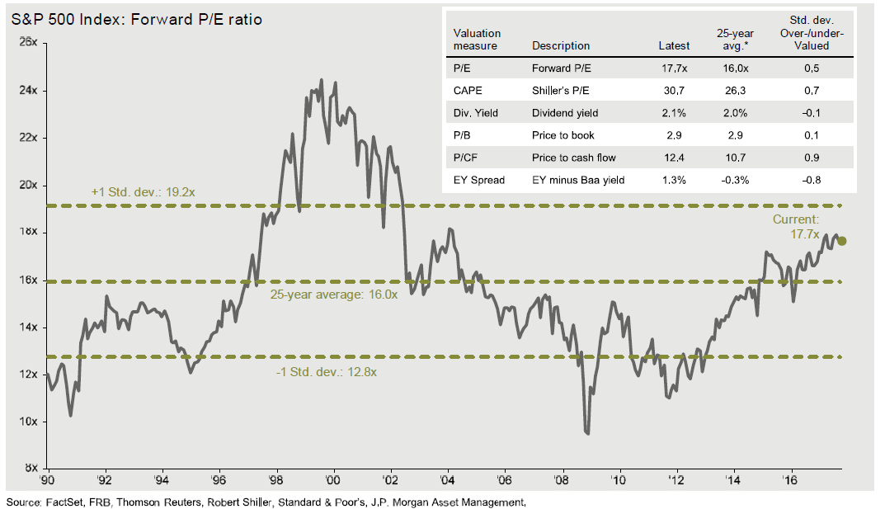
So are valuations extreme?
Data as of 09/30/17
Becker Capital Management

Slide 30
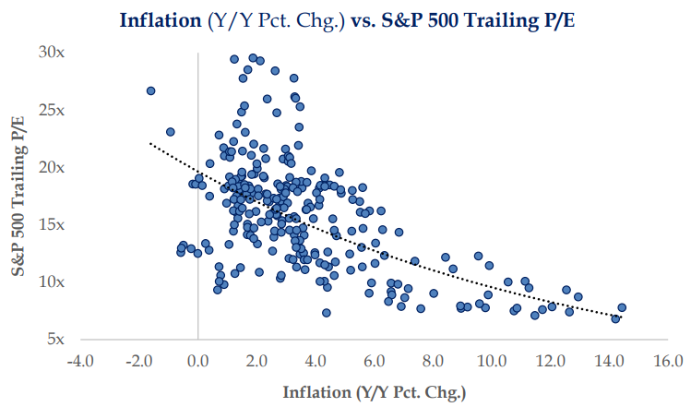
Valuations tend to be elevated in periods of low inflation and low interest rates
Source: Strategas
Data as of 10/02/17
Becker Capital Management

Slide 31
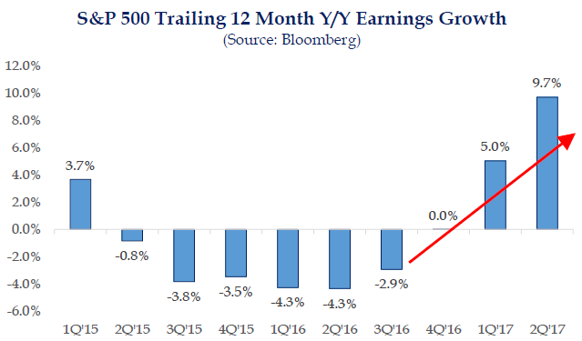
And earnings growth is actually accelerating
Becker Capital Management

Slide 32
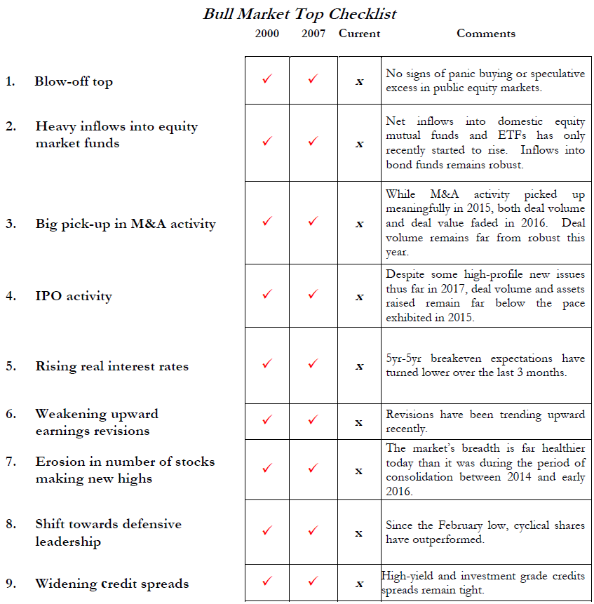
Source: Strategas
Data as of 10/02/17.
Becker Capital Management

Slide 33
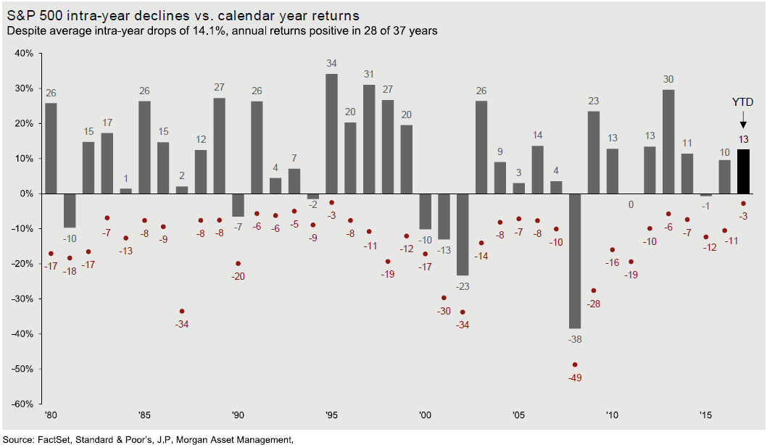
So while we maybe overdue a market pullback, we are still happy to own stocks for the long-run
Data as of 09/30/17
Becker Capital Management

Slide 34
Disclosure
The opinions expressed represent those of the individual not the firm, and is not intended to be a forecast of future events, a guarantee of future results, nor investment advice. The information contained in this document is not guaranteed as to its accuracy or completeness. The information included in this document does not provide information reasonably sufficient upon which to base an investment decision and should not be considered a recommendation to buy or sell any particular security. Furthermore, this material should not be considered an offer to buy or sell any security.
Becker Capital Management

