Slide 1
Inside Look at Recent Events and Priorities of the Department of Labor - EBSA
Jennifer Keim, CPA, CEBS
Auditor
Employee Benefits Security Administration
U.S. Department of Labor
Washington, D.C.
The views expressed are those of the speaker and do not necessarily represent the official position of the Department.

Slide 2
Overview
ERISA’s Landscape
Meet OCA
Reporting Enforcement
Audit Quality Trends
Audit Quality Enforcement
Plan Professionals – a Myriad of Roles & Responsibilities
Outreach/Compliance Assistance

Slide 3
ERISA’S LANDSCAPE
3
Nearly 149 million workers, retirees, and dependents of private sector pension & welfare plans
2.3 million health plans
A similar number of other welfare plans
703,000 private pension plans
Estimated assets of $9.8 trillion

Slide 4
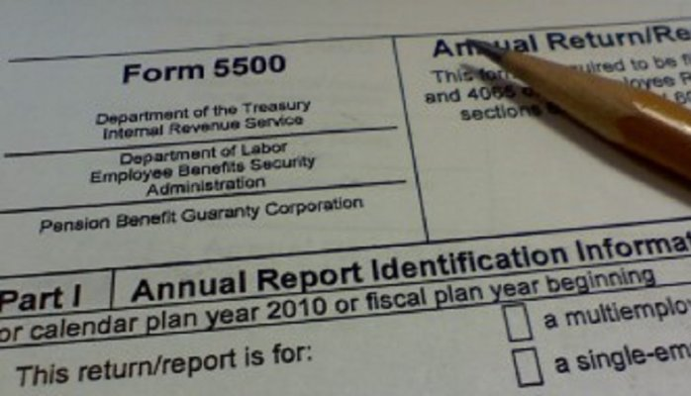
Meet The Office of the Chief Accountant
4

Slide 5
Reporting Compliance Activities
Stop filer Initiatives
Missing/Rejectable IQPA Reports
Form 5500 and M-1 Compliance
Joint DOL/IRS Enforcement Initiatives
DFVC Integrity Review

Slide 6
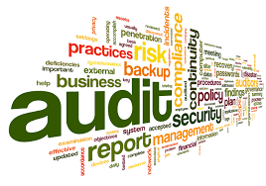
Audit Landscape
84,109 plans are subject to audit
131.8 million participants
$8 trillion in assets subject to audit
5,484 CPA firms performing audits

Slide 7
Audit Quality Enforcement
200+ Audits
CPA firm inspections
How does firm manage audit practice
100-199 Audits
How does firm manage practice
Review of several audit engagements
Less than 100 Audits
Review of individual audit engagement
Targeting is more statistically based

Slide 8
Audit Quality Remains Problematic
Deficiency rates are unacceptable—nearly 40%
Large variability—size of EBP practice is a factor
Large firms not immune from problems—they often dabble
The size of large firms brings own risks and challenges
Peer review is limited as an indicator of a quality benefit plan auditor

Slide 9
Themes of Deficient Audit Work
9
Documentation
Overreliance
Checklists – the good, the bad, and the ugly
Lack of audit experience – EBP or otherwise

Slide 10
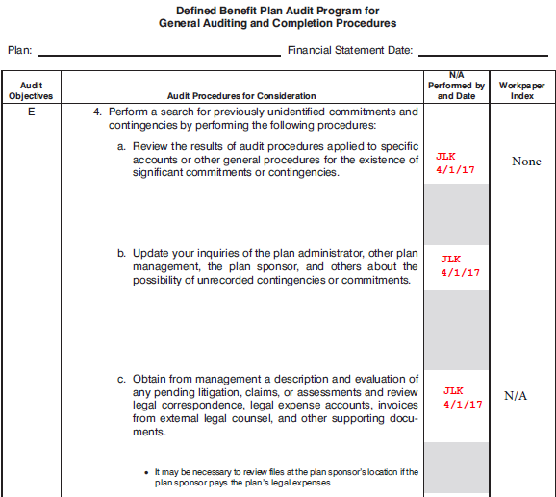
Audit Documentation – Example 1

Slide 11
Themes of Best Practices
Commitment to EBP work from top down
An audit pedigree within the firm
EBP-specific training and affiliation
EBP specialists
Robust internal inspection program
Knowing who you are and when to say “no”

Slide 12
Audit Firm Risk
12
Rejection of client’s filing
Referral of deficient work to AICPA and state board
Damage to professional reputation
Threat to professional license and livelihood
Even possible criminal charges

Slide 13
Disciplinary Referrals
State Board of Accountancy
70 referrals = 2018
60 referrals = 2017
38 referrals = 2016

Slide 14
Client Risk
14
Fiduciary risk for lack of prudence in selecting a qualified CPA firm
Potential rejection of Form 5500 filing due to deficient audit work
Potential assessment of civil monetary penalties

Slide 15
Enforcement Process
15
Inquiry Letter
Notice of Rejection Letter
Notice of Intent to Assess a Penalty Letter
Notice of Determination Letter
Administrative Law Appeal

Slide 16
Take Away
16
Pay attention to DOL correspondence
Respond in a timely manner
Call if you have questions

Slide 17
Pay Attention to DOL Correspondence
In our audit review cases,
20% of cases result in further enforcement action
30% of these cases result in financial civil penalties
These statistics are likely higher for general reporting compliance matters.

Slide 18
Outreach/Compliance Assistance
EBSA Website www.dol.gov/ebsa
Delinquent Filer Voluntary Compliance Program (DFVC)
Voluntary Fiduciary Correction Program (VFCP)
DOL EFAST Help Desk 1-866-463-3278
Conferences and Training

Slide 19
Outreach/Compliance Assistance
Participation in the following Task Forces
AICPA EBP Reporting
Multi-employer Audit Guide Chapter

Slide 20
DOL Resources
www.dol.gov/ebsa
For DOL publications, FAQs, copies of the Form 5500, instructions, and related schedules
EBSA Office of the Chief Accountant 202-693-8360
EBSA Office of Regulations and Interpretations 202-693-8500
For questions about ERISA reporting, filing or other regulatory requirements
DOL EFAST Help Center 1-866-463-3278
For questions regarding the Form 5500 or related schedules

Slide 21
Appendices – DOL Expectations for Audit Areas

Slide 22
DOL Expectations – Area by Area
Indirect Financial Statement Areas
Planning
Internal Controls
Participant Data

Slide 23
Planning and Supervision
Obtain the plan document and understand plan operations
Identify risks for each plan audit and design audit procedures specific to the risks
Do not blindly rely on the work of a specialist
23

Slide 24
Internal Controls
Understand plan internal controls and related risks
Auditor should recognize and communicate deficiencies in internal controls
Documentation should be current
MAP SOC 1 Reports – understand your audit tool!
24

Slide 25
Participant Data
Impacts eligibility, contributions, investments, and benefit payments
Understand the basis behind testing participant data
Nature of plan dictates participant risk and audit response
Same testing regardless of full scope or limited-scope audit
Eligibility Testing
Have participants been properly included in the plan?
Have participants been properly excluded from the plan?
25

Slide 26
DOL Expectations – Area by Area
Direct Financial Statement Areas
Subsequent Events
Parties-In-Interest
Contributions
Benefit Payments
Investments

Slide 27
Party-in-Interest Transactions
Understand the definition of a party in interest and how it differs from a related party
Understand types of transactions that may be prohibited
Understand the roles of the parties
Develop a list of the parties and communicate it to audit staff
Ensure that footnotes appropriately consider prohibited transactions
Seek out legal advise where necessary
27

Slide 28
Contributions
Ensure that the plan has received the proper amount of contributions
Understand the definition of compensation
Determine that participants’ elections have been properly handled
Test for the timeliness of employee contributions
Understand the payroll system used to compute contribution amounts
28
Notes:
Multi-employer plans present unique challenges

Slide 29
Audit Documentation – Example 2
XYZ 401(k) Plan
Contribution Testing
12/31/2016
Note 1: | No employer contributions.
 |  |  | Deferral
 | Participant name | Wages | % | Deferrals
1 | Jane Smith | $ 114,535.20 | 8.000% | $ 9,162.82 | X
2 | John Doe | $ 67,445.21 | 5.000% | $ 3,372.26 | X
3 | Sally Weis | $ 90,091.28 | 9.296% | $ 8,374.89 | X
4 | Mary Peters | $ 143,322.09 | 20.000% | $ 26,000.00 | X
5 | Gary Jones | $ 18,678.26 | 1.000% | $ 186.78 | X
X | Recalculated deferrals withheld and agreed to payroll records and TPA records. Appears proper.
29

Slide 30
Audit Documentation – Example 3
XYZ 401(k) Plan
Contribution Remittance Testing
12/31/2016
Procedures: | To test the timeliness of contribution remittances, we selected 5 pay periods during the year noting the pay date and date contributions were remitted to the custodian. Per inquiry with plan management, contributions are always remitted 4 days after pay date. For all selections tested, the contribution was remitted before the 15th day of the following month. As such, contributions appear timely remitted. The following pay periods were tested:
 | Pay Date
1 | 1/31/2016
2 | 6/30/2016
3 | 7/31/2016
4 | 9/15/2016
5 | 11/30/2016
30

Slide 31
Benefit Payments
Ensure that payments are made in accordance with plan terms
Test the eligibility of those receiving benefits
Re-compute benefit payments, where appropriate
Test for appropriate treatment of forfeitures
Properly rely on SOC-1 report – know who does what
31

Slide 32
Audit Documentation – Example 4
XYZ 401(k) Plan
Benefit Payment Testing
12/31/2016
 |  | Distribution | Distribution | Cancelled
 | Participant name | Date | Amount | Check Amount
1 | Jane Smith | 2/4/2016 | $ 43,877.66 | $ 35,102.13 | X | Y
2 | John Doe | 5/17/2016 | $ 31,719.28 | $ 22,917.18 | X | Y
3 | Sally Weis | 9/21/2016 | $ 4,598.03 | $ 2,877.76 | X | Y
4 | Mary Peters | 7/8/2016 | $ 5,000.00 | $ 4,500.00 | X | Y
5 | Gary Jones | 12/14/2016 | $ 19,014.67 | $ 19,014.67 | X | Y
X | Obtained and agreed to supporting documents. Appears proper.
Y | Agreed to cancelled check. Appears proper.
32

Slide 33
Investments – Limited Audits
Understand who qualifies to issue certification
Obtain certification letter AND RELATED CERTIFIED INVESTMENT INFORMATION
Understand which investments and investment information is certified
Understand that other data (contributions, benefit payments, participant data, allocations of income and investments) must still be audited.
33

